Slide 1
Analysis of SAT Scores and Crime
Caleb Ralphs, Vital Tavares and David Larson

Slide 2
Introduction
Evaluate correlation between standardized test scores and crime rates in New York City
Heavily laden with social implications
Correlation can provide diagnosis for public security issues
Provide scholarly motivation for kids based on their futures
Notes:
We decided to do our analysis on the correlation between average SAT scores from New York City high schools and crime rates in the various boroughs in NYC. There is often thought to be a significant correlation between crime and education, so we wanted to see if we could see this correlation in these datasets that we found. If such a correlation exists, it can be used to provide motivation for students to work harder in the classroom and also provide a way for governments to try to control crime rates.

Slide 3
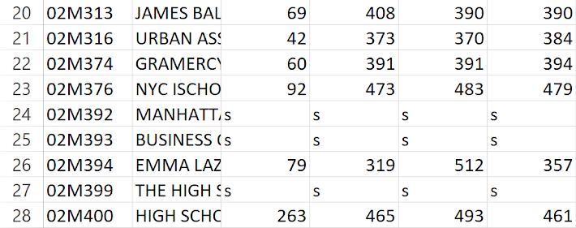
The Data
SAT scores from 2012 and 2014
Scores from each section
DBN (District Borough Number) for each school
Longitude and Latitude
NYPD Complaint Data
Contains all complaints filed to the NYPD between 2006-2015
Type of crime, date, time, latitude and longitude
Notes:
We were able to find three datasets we intended to use. The first set came from data.gov, and contains the average reading, writing, and math scores for each high school in New York city along with the DBN, the number of test takers, and the name of the high school. The second dataset came from NYC open data, and contained other

Slide 4
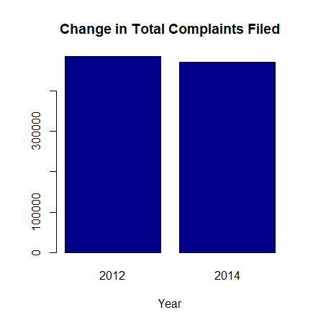
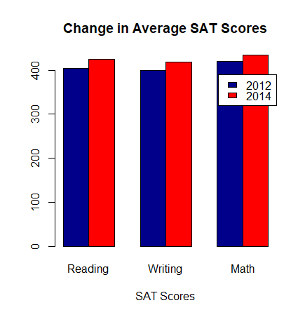
Crime and SAT Data vs. Time
484602
471642

Slide 5
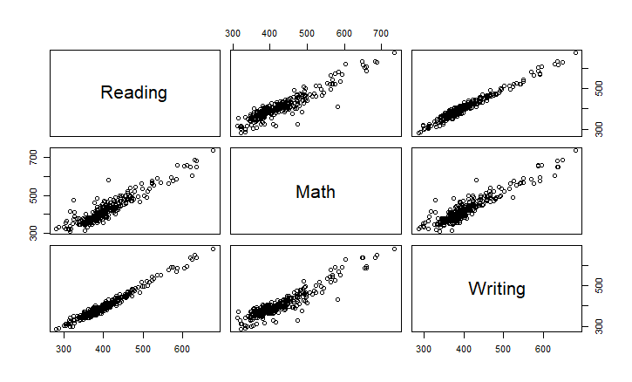
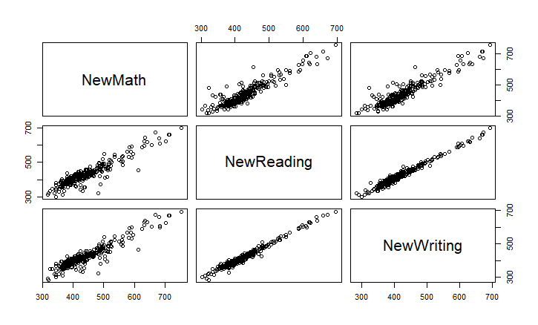
SAT Subject Score Correlation
2012
2014

Slide 6
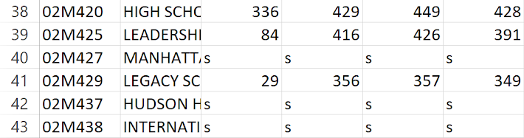

Feature Engineering - Data Cleaning
2012 SAT Scores Dataset
Used ‘s’ to represent null values
Data omitted for < 5 test takers
2014 SAT Scores
Simply left data empty for null
NYPD Complaint Dataset
Has data from 2006-2015, only need from
2012 and 2014
Can’t use data with no date or latitude/longitude

Slide 7
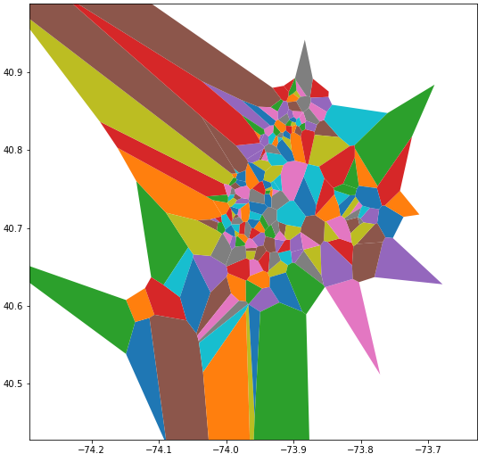
Feature Engineering
SAT scores by school -> crime by coordinates
Devised “districts” using Voronoi diagram
Region represents a district containing one school
All points in region are closest to that school
Allows for relation of schools to coordinate

Slide 8
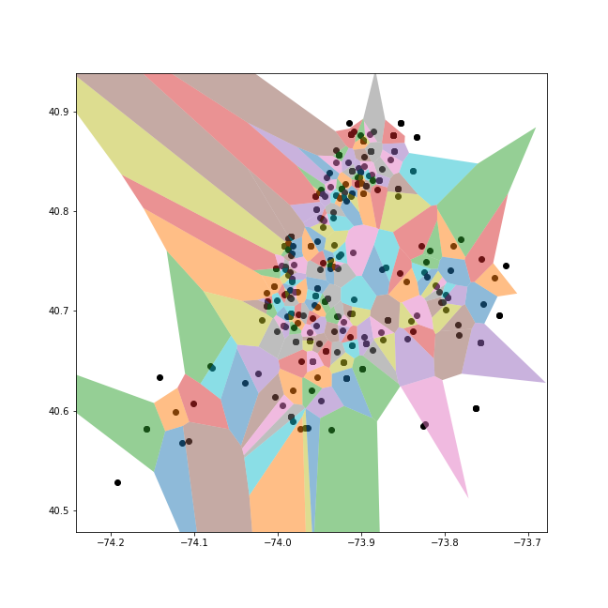
Feature Engineering cont.

Slide 9
Feature Engineering - Unforeseen Roadblock
Created two dictionaries in python:
DBN -> polygon, crime frequency
Polygon -> DBN (Faulty)
Had a problem mapping polygon to DBN
Implemented an algorithm that chose the appropriate DBN based on the coordinates in a similar manner

Slide 10
Computational Limitations
Intent was to correlate SAT scores with entirety of crime dataset
Euclidean distance algorithm on millions of data points - extremely inefficient
Time complexity O(n^2)
Decided to take samples of crime data set in groups of 50,000
Generated uniformly distributed random numbers to sample data
Each sample took approximately an hour to compute
Set aside a set of 50,000 as testing data
Used 4 sets of 50,000 as training data

Slide 11
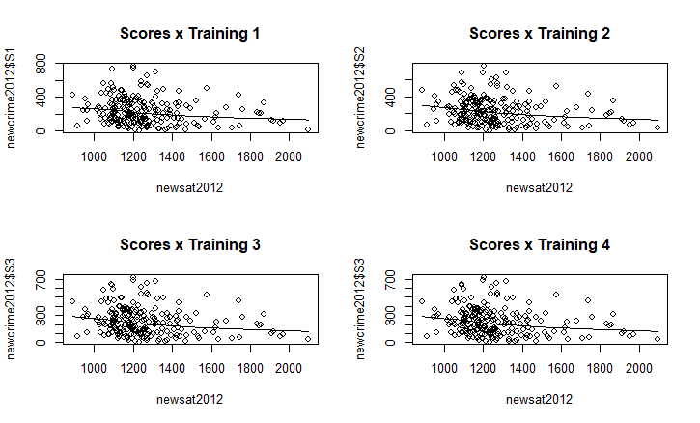
Regression Model

Slide 12
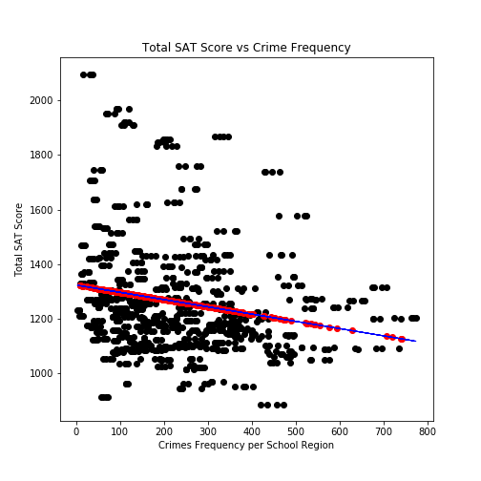
Regression Model
Training data extremely similar to test data
Due to sampling method
When we predict the testing data, we will experience a low mean squared error
Testing Error Metrics
Mean error: 152.70
Mean Percentage Error: 11.71%
Mean Squared Error: 45598.07

Slide 13
Conclusions
R-squared errors were non ideal
Probably due to the following reasons
Crime can be attributed to many factors
Real estate speculation, income, unemployment, population density, poverty rate…
Education is probably one of these predictors
SAT scores represent only a small slice of the actual education of a region
Cannot confidently report a correlation between SAT scores and crime rates in a given district in NYC
Failed to find a correlation, but we experienced the most successful possible failure

